Slide 1
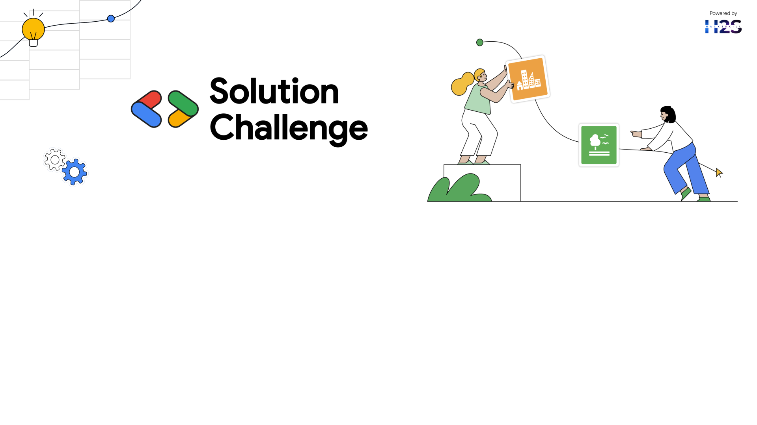
Team Details
Team name: Team NextGen
Team leader name: Saikat Das
Problem Statement: Empowering Small and Marginal Farmers with AI-Driven Agricultural Solutions

Slide 2

Brief about your solution
This solution is a collaboration work of AI, Machine Learning to empower small and marginal farmers by providing personalized agricultural insights.
🔹 AI-Powered Crop Recommendation – Predicts the best crop based on soil health, weather’s historical data. 🔹 Yield Prediction Model – Uses weather patterns, soil moisture, and past trends to forecast crop productivity. 🔹 Soil Health Monitoring – Collected Survey data on the location’s soil data helps to improve soil quality. 🔹 Web Application – Provides real-time access to AI-driven advisory for farmers.
Impact
Increases Yield & Reduces Losses
Optimizes Resource Usage (Water, Fertilizers)
Enhances Climate Resilience
Improves Farmers' Livelihoods

Slide 3
Opportunities
Unlike traditional agricultural advisory systems ideas, this AI-powered solution provides real-time, personalized recommendations based on machine learning, Artificial intelligence. This system continuously learns and adapts to changing climate, soil, and market conditions.
How Will It Solve the Problem?
✅ Data-Driven Crop Selection – AI recommends the best crops based on soil health, weather forecasts, and historical data. ✅ Precision Farming – IoT sensors and satellite data enable real-time monitoring of soil, water, and weather conditions. ✅ Early Pest & Disease Detection – AI detects crop diseases early using image recognition and sensor data, reducing losses. ✅ Smart Irrigation & Resource Management – AI optimizes water and fertilizer usage, preventing overuse and ensuring sustainability.
Most Essential Problem Focused Solution 🔹 Localized & Personalized Advice – Provides customized recommendations based on farm-specific data. 🔹 Climate-Resilient Farming – Helps farmers adapt to unpredictable weather patterns. 🔹 Market Linkages & Financial Support – Connects farmers with buyers, government schemes, and financial resources.

Slide 4
List of features offered by the solution
AI-Powered Crop & Seed Selection – Uses ML to recommend optimal crops and high-yield seeds based on soil quality, weather, and past yield data.
Climate & Weather Prediction – Provides real-time weather forecasts and AI-driven risk analysis to mitigate climate threats.
Disease & Pest Detection – Uses image-based AI to identify pests and diseases, suggesting effective organic or chemical treatments.
Smart Soil Management – Analyzes soil health and recommends fertilizers, promoting sustainable farming practices.
Market Price Prediction & Direct Selling – Forecasts crop demand and prices while connecting farmers to buyers and government schemes.
Web-Based Platform for Easy Access
A farmer-friendly mobile & web app for real-time access to all AI-driven recommendations.

Slide 5
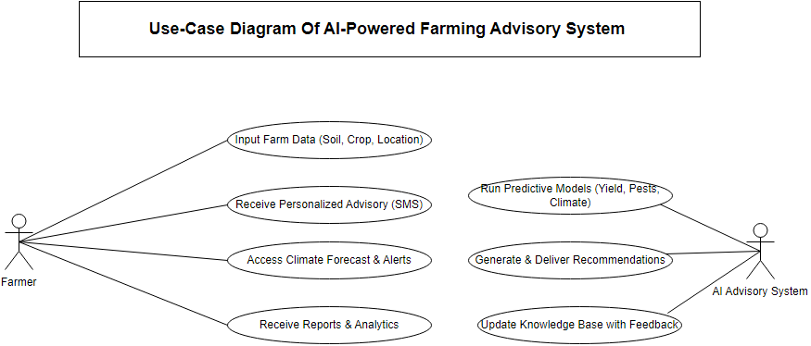
Process flow diagram or Use-case diagram

Slide 6
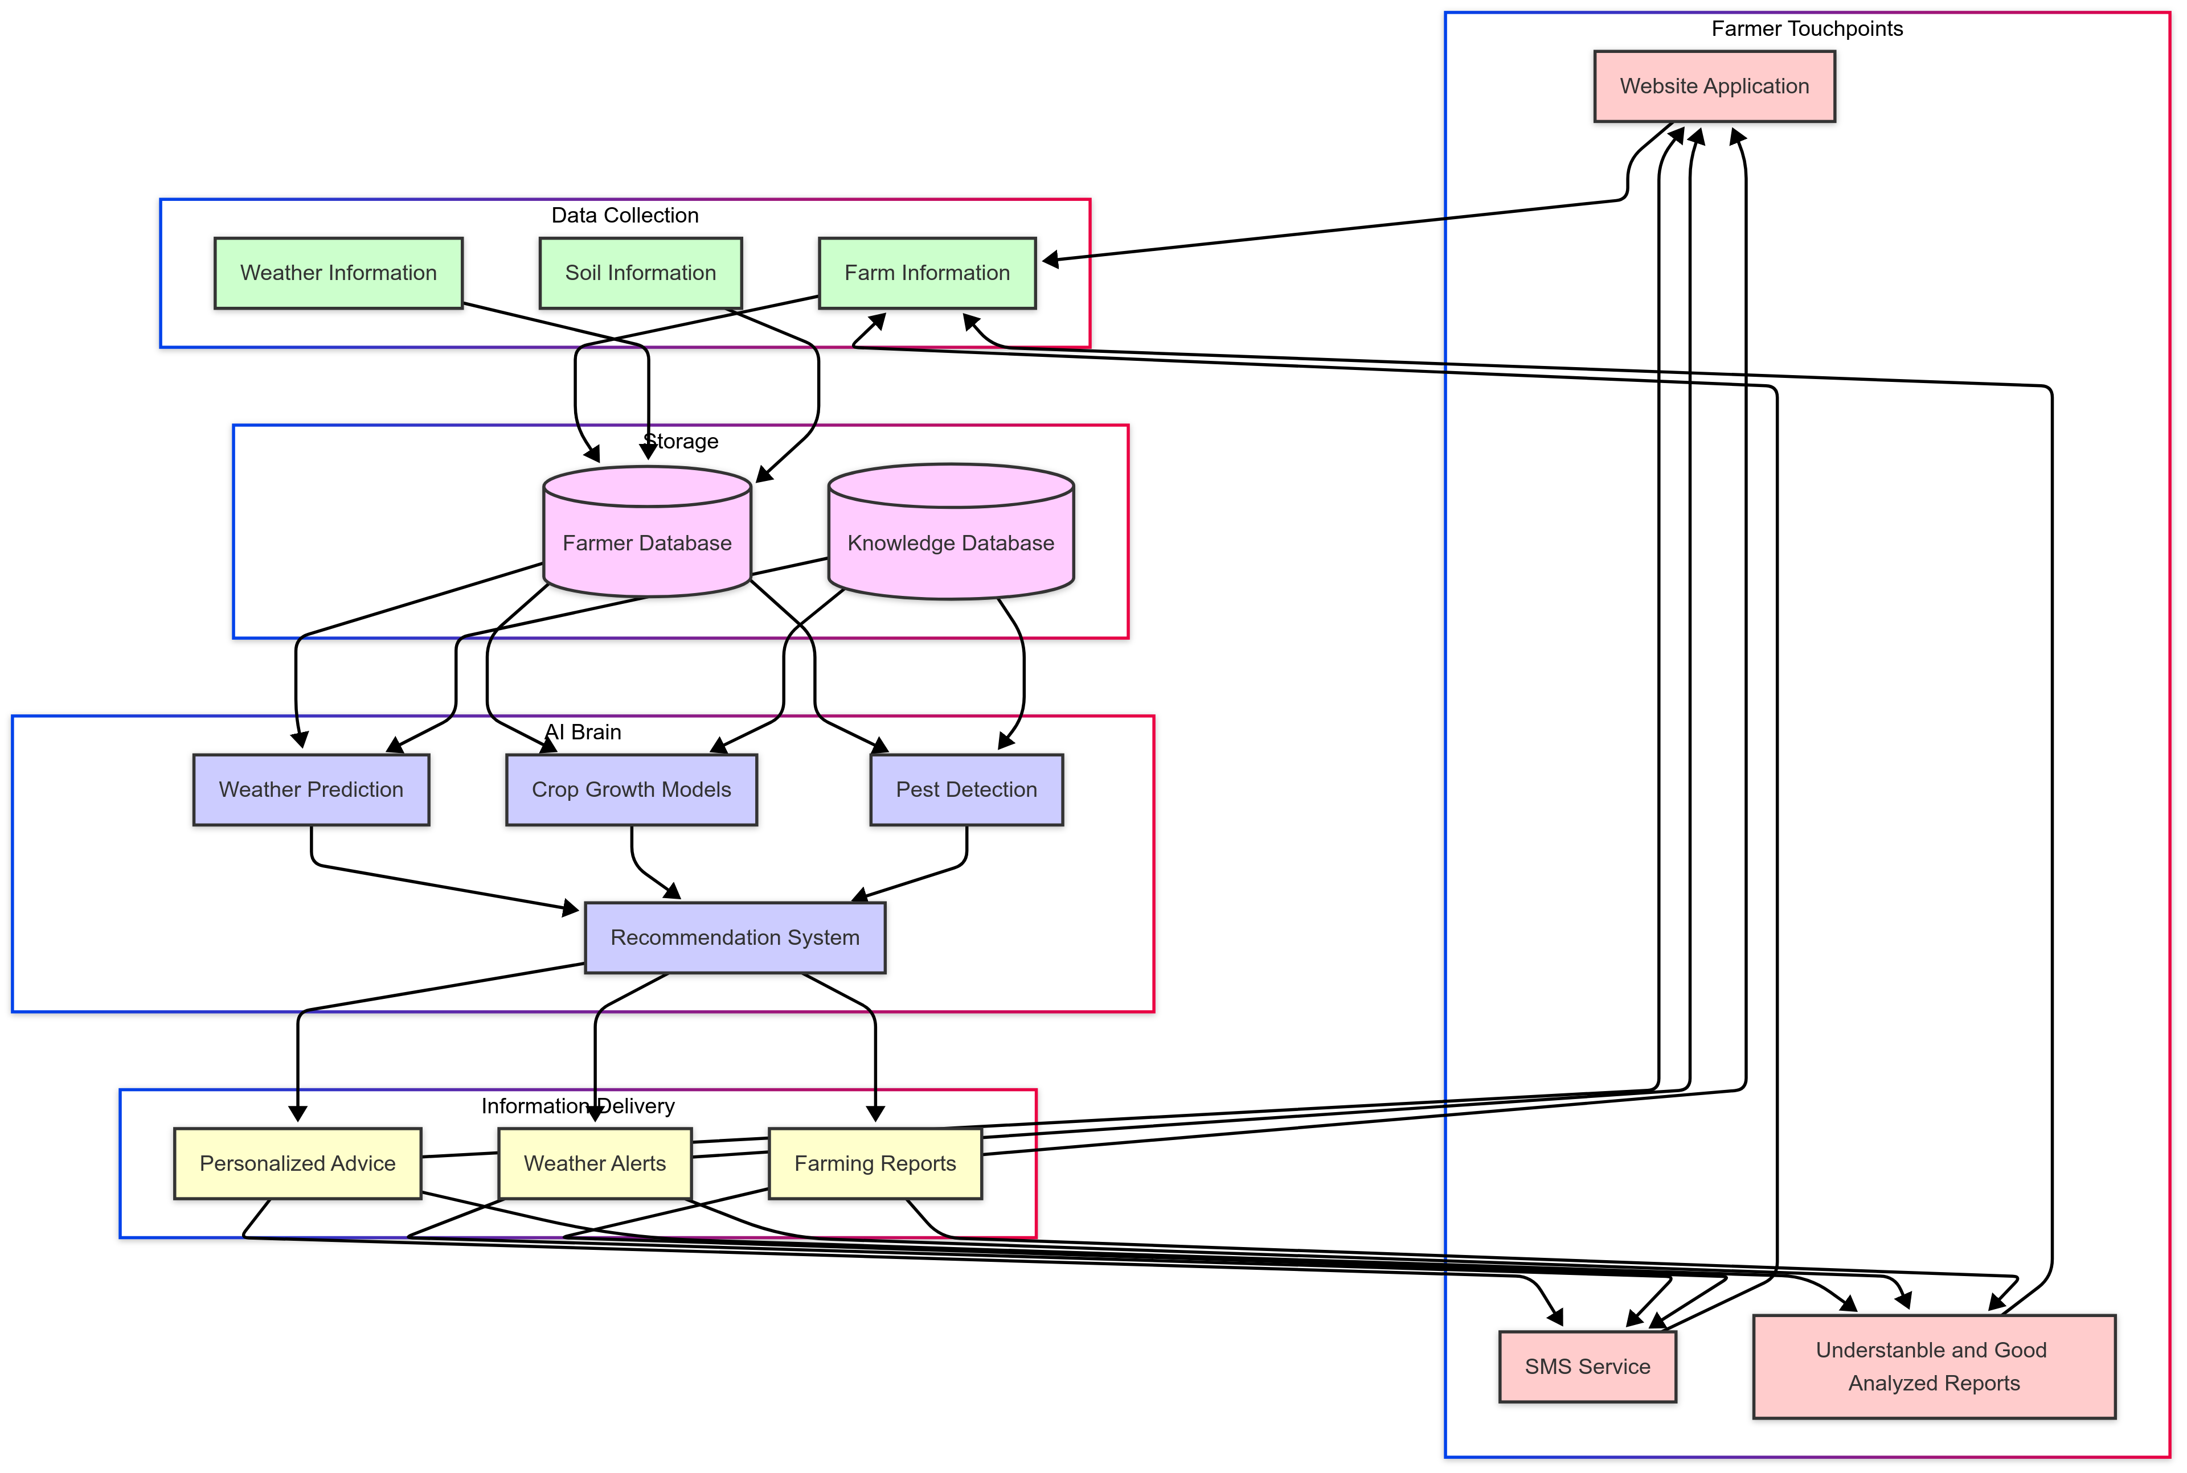
Architecture diagram of the proposed solution

Slide 7
Technologies to be used in the solution
HTML,CSS(Frontend)
Machine Learning
MongoDB,JAVASCRIPT(Backend)
Weather API(OpenWeather.com)
Soil API(AgroMonitoring.com)

Slide 8
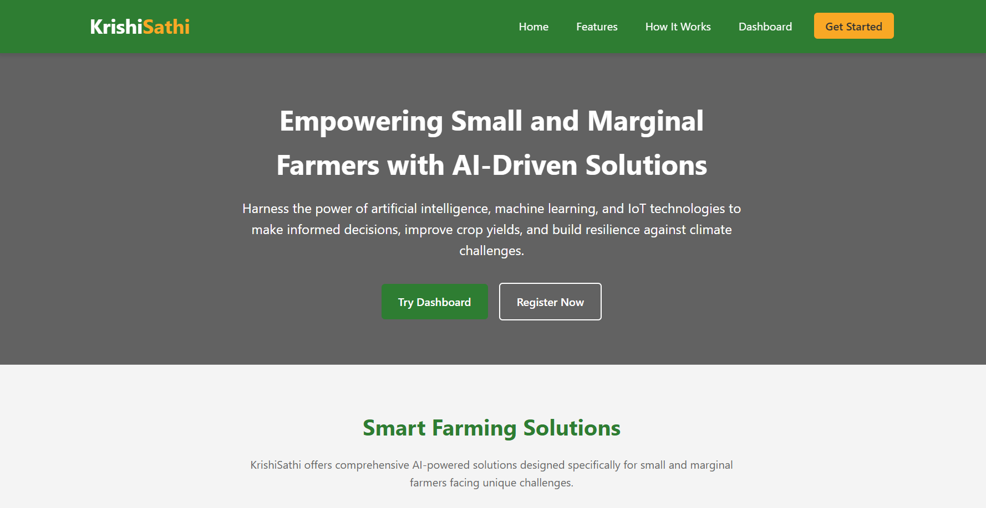
Snapshots of the MVP

Slide 9
Additional Details/Future Development (if any)
Add the Good Database System for Farmers.
Add a Community Section for all the local farmers.
Add a Tutorial section for learning
Add a Market Place where Farmers get the perfect pricing for their corps.

Slide 10
Provide links to your:
GitHub Public Repository : https://github.com/SaikatDash/Empowering-Small-and-Marginal-Farmers-with-AI-Driven-Agricultural-Solutions
Demo Video Link (3 Minutes) :
MVP Link : KrishiSathi - AI-Driven Agricultural Solutions

Slide 11


